Slide 1
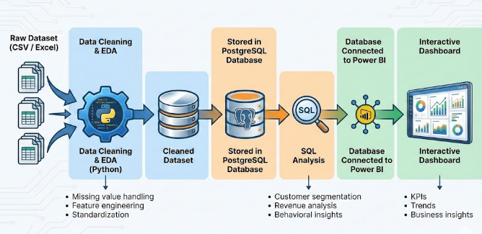
Retail Customer Behavior Analysis
Deep-dive insights into 3,900 purchases to drive strategic business decisions.

Slide 2


Dataset Overview
Our analysis is built on a robust dataset of 3,900 transactions, capturing a comprehensive view of the modern shopper's journey.
Customer Profiles
Age (18-70), Gender, Location, and Subscription Status.
Purchase Details
Category, Amount, Season, Size, and Color.
Behavioral Data
Shipping type, Frequency, and Review Ratings (avg 3.75).

Slide 3
Data Preparation & Engineering
Before analysis, we utilized Python and Pandas to ensure data integrity and create advanced features for deeper segmentation.
01
02
03
Cleaning & Imputation
Feature Engineering
Database Integration
Filled missing Review Ratings using the median of each product category.
Created age groups and purchase frequency metrics for better targeting.
Standardized columns and loaded cleaned data into PostgreSQL for SQL analysis.

Slide 4
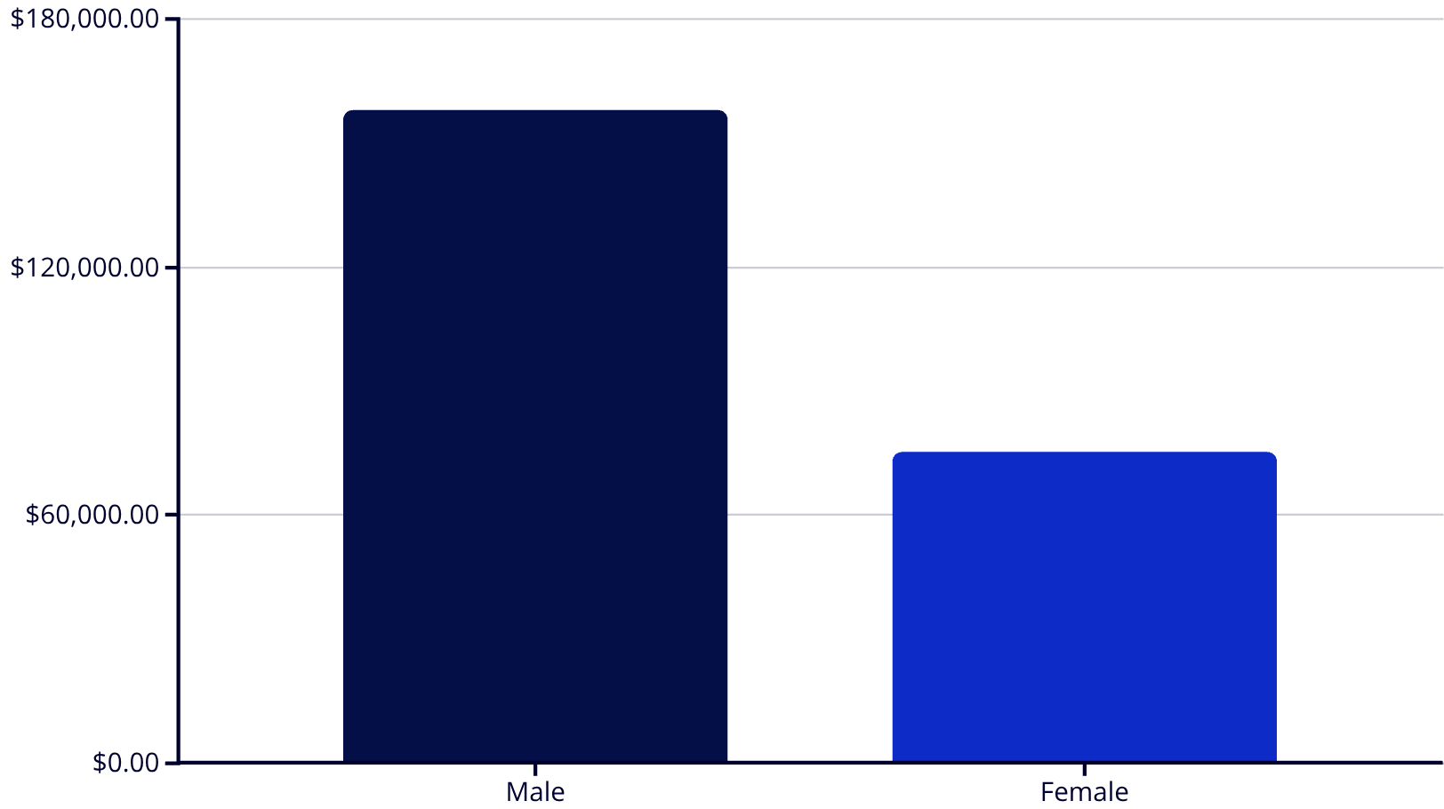
Revenue & Spending Insights
Key Findings
Male customers contribute significantly higher total revenue ($157.8k).
839 high-spending customers use discounts but still exceed average spend.
Express shipping users spend more on average ($60.48) than standard users ($58.46).

Slide 5
Top Rated & Discounted Products
Understanding the relationship between customer satisfaction and price sensitivity.
Top 5 Rated Items
Percentage sold on Discount
Item
Rating
Item
Rate
Gloves
3.86
Hat
50.0%
Sandals
3.84
Sneakers
49.6%
Boots
3.82
Coat
49.0%
Hat
3.80
Sweater
48.1%
Skirt
3.78
Pants
47.3%

Slide 6
Subscription & Loyalty Analysis
While non-subscribers drive more total volume, subscribers represent a stable core of the business.
1053
2847
3116
Subscribers
Non-Subscribers
Loyal Segment
Generating $62,645 in total revenue.
Contributing $170,436 to the bottom line.
The vast majority of our customer base.
958 Subscribed
Repeat Buyers
Subscribers

Slide 7
Category Performance
A breakdown of the top-performing items across our four primary product categories.
Accessories
Clothing
Jewelry (171 orders), Sunglasses, and Belts.
Blouses (171 orders), Pants, and Shirts.
Footwear
Outerwear
Sandals (160 orders), Shoes, and Sneakers.
Jackets (163 orders) and Coats.

Slide 8
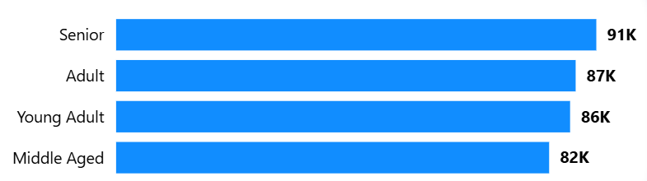
Revenue by Age Group
Spending is remarkably balanced across generations, with Young Adults leading slightly.

Slide 9

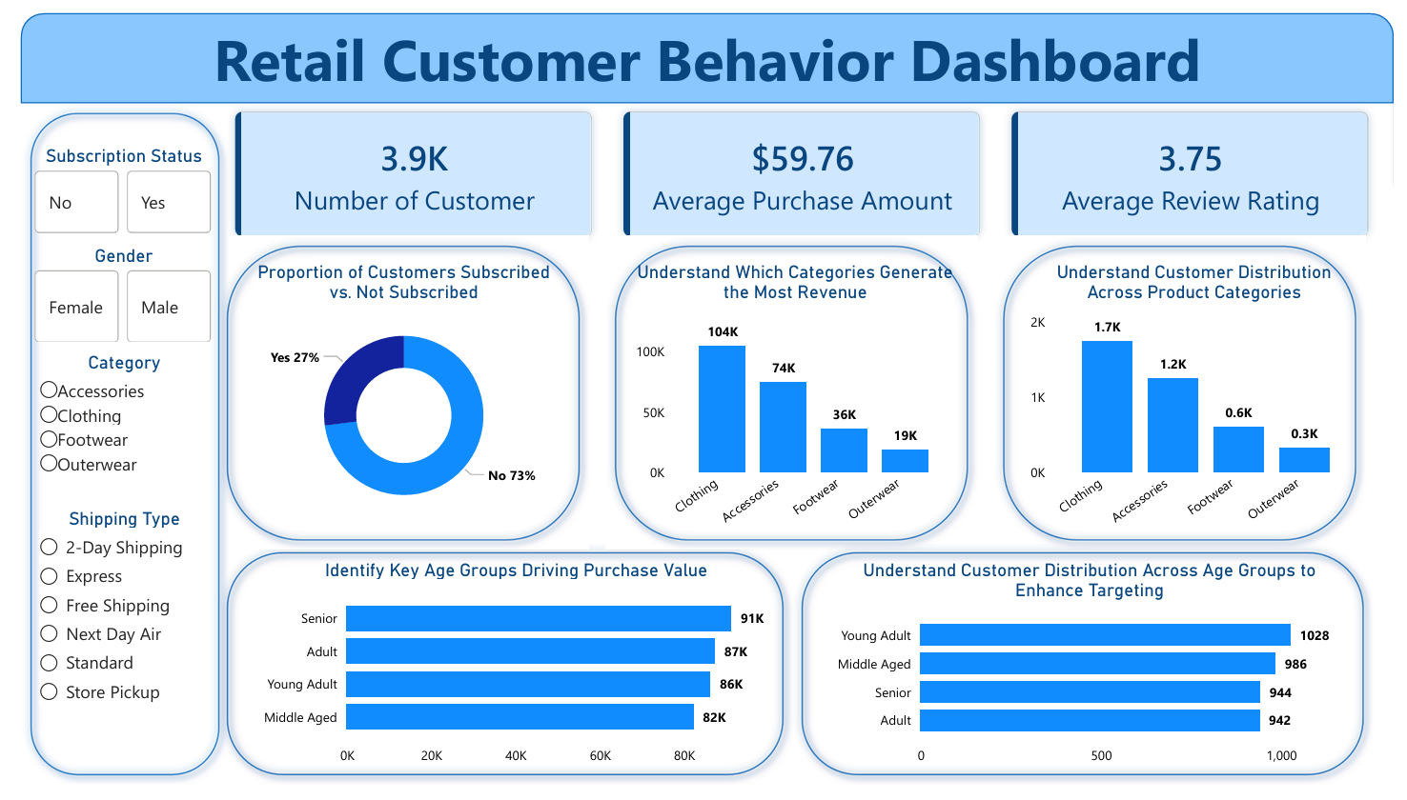
Interactive Dashboard
Our Power BI dashboard provides real-time visualization of these key retail metrics.
The dashboard allows for filtering by season, location, and subscription status to uncover localized trends.

Slide 10
Strategic Recommendations
Boost Subscriptions
Targeted Marketing
Optimize Discounts
Offer exclusive benefits to convert the non-subscribed repeat buyers.
Focus efforts on high-revenue Young Adults and Express Shipping users.
Refine discount policies for "Discount-Dependent" items like Hats and Sneakers to protect margins.

